Slide 1
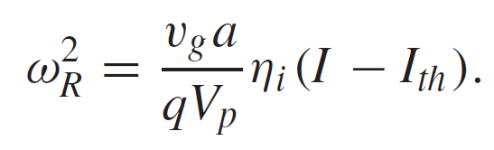
3D Optical investigation of Mode Volume
Optical mode size influences the high frequency performance

Slide 2
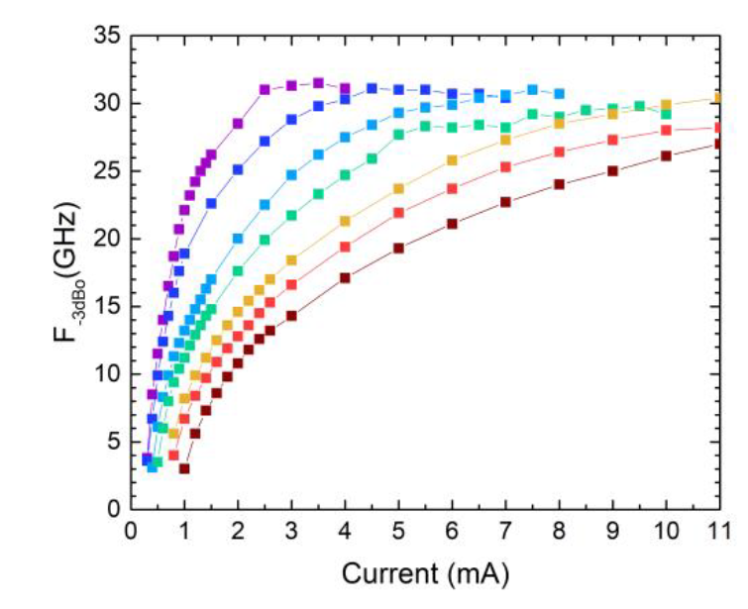
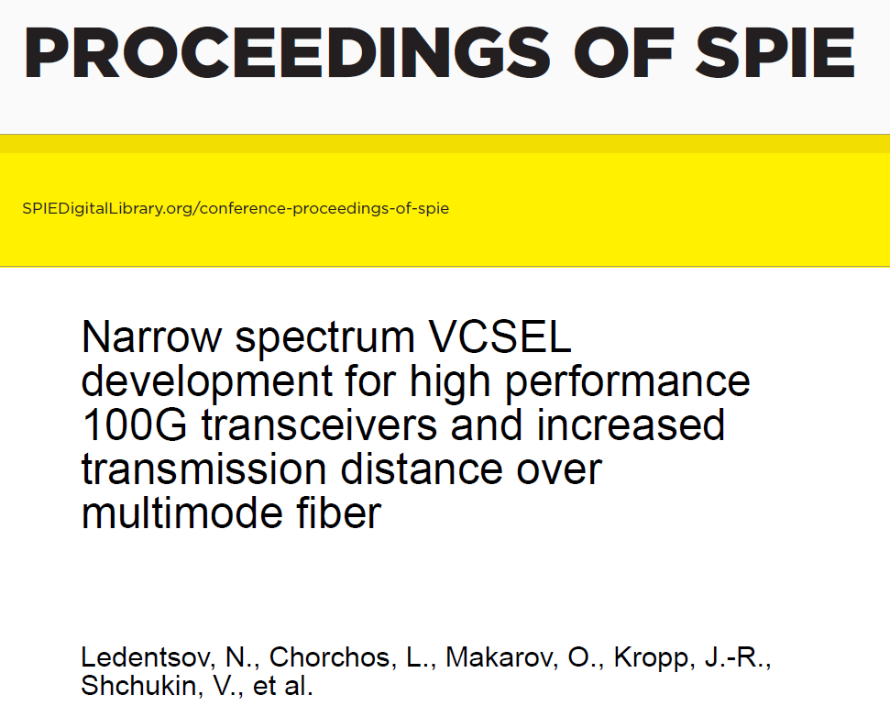
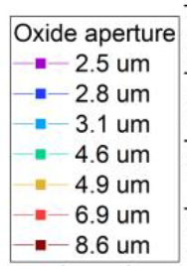
1.25 um radius
2021

Slide 3
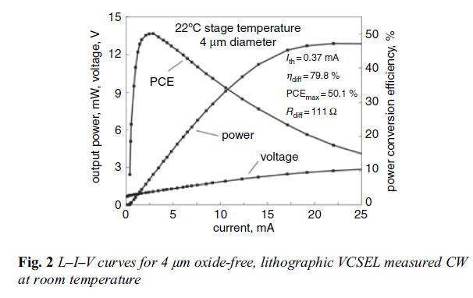
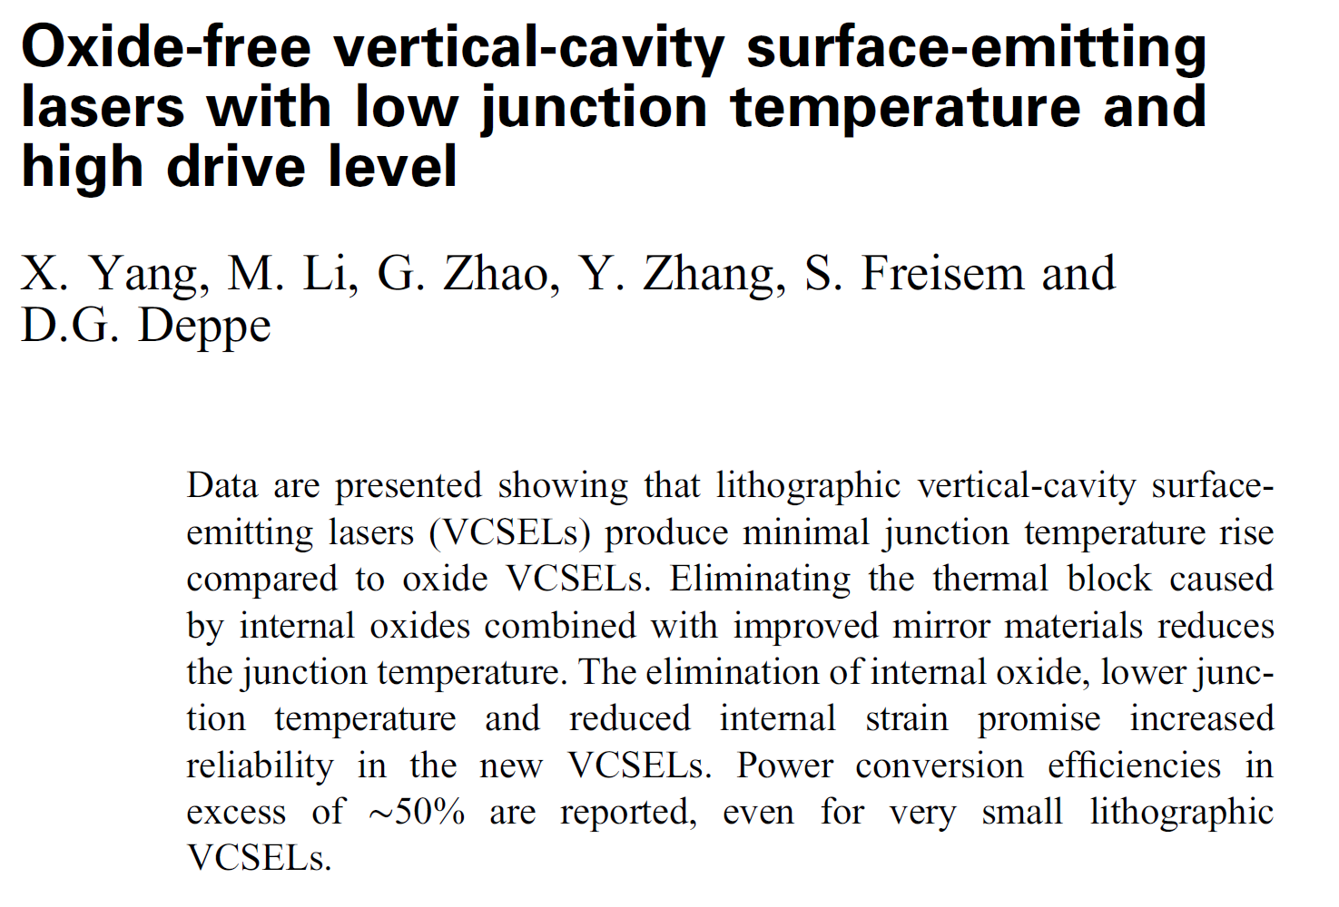
Lithographic defined VCSELs
Higher performance due to elimination of strain induced by the oxide and better thermal performance
Current confinement by proton implantation?
Not clear why thermal behavior is that better.

Slide 4
TJ VCSELs combine all those advantages in one stroke !
Elimination of strain induced by the oxide, the ultimate reason for reliability issues

Slide 5
TJ VCSELs combine all those advantages in one stroke !
Elimination of strain induced by the oxide, the ultimate reason for reliability issues
Precisely defined optical and electrical confinement

Slide 6
TJ VCSELs combine all those advantages in one stroke !
Elimination of strain induced by the oxide, the ultimate reason for reliability issues
Precisely defined optical and electrical confinement
Better heat behavior

Slide 7
TJ VCSELs combine all those advantages in one stroke !
Elimination of strain induced by the oxide, the ultimate reason for reliability issues
Precisely defined optical and electrical confinement
Better heat behavior
Smaller Mode volume

Slide 8
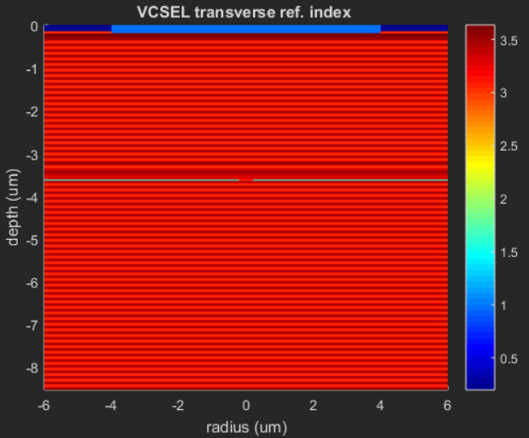
Optical mode size in Oxide/Relief confined VCSELS
Standard Oxide VCSEL
Contact Ring

Slide 9
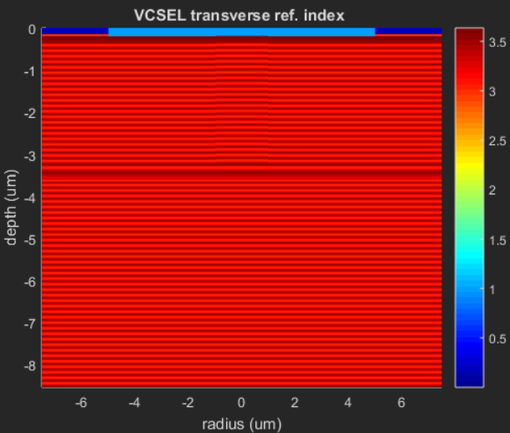
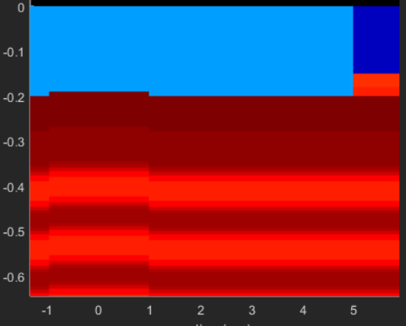
Optical mode size in Oxide/Relief confined VCSELS
Standard Oxide VCSEL
TJ VCSEL
Contact Ring
10nm TJ Relief

Slide 10
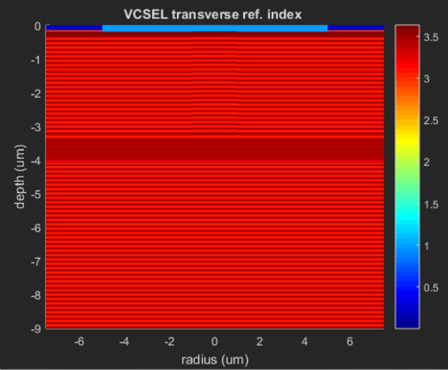
Optical mode size in Oxide/Relief confined VCSELS
Standard Oxide VCSEL
TJ VCSEL
3 TJ VCSEL
Contact Ring
3 λ cavity
10nm TJ Relief

Slide 11
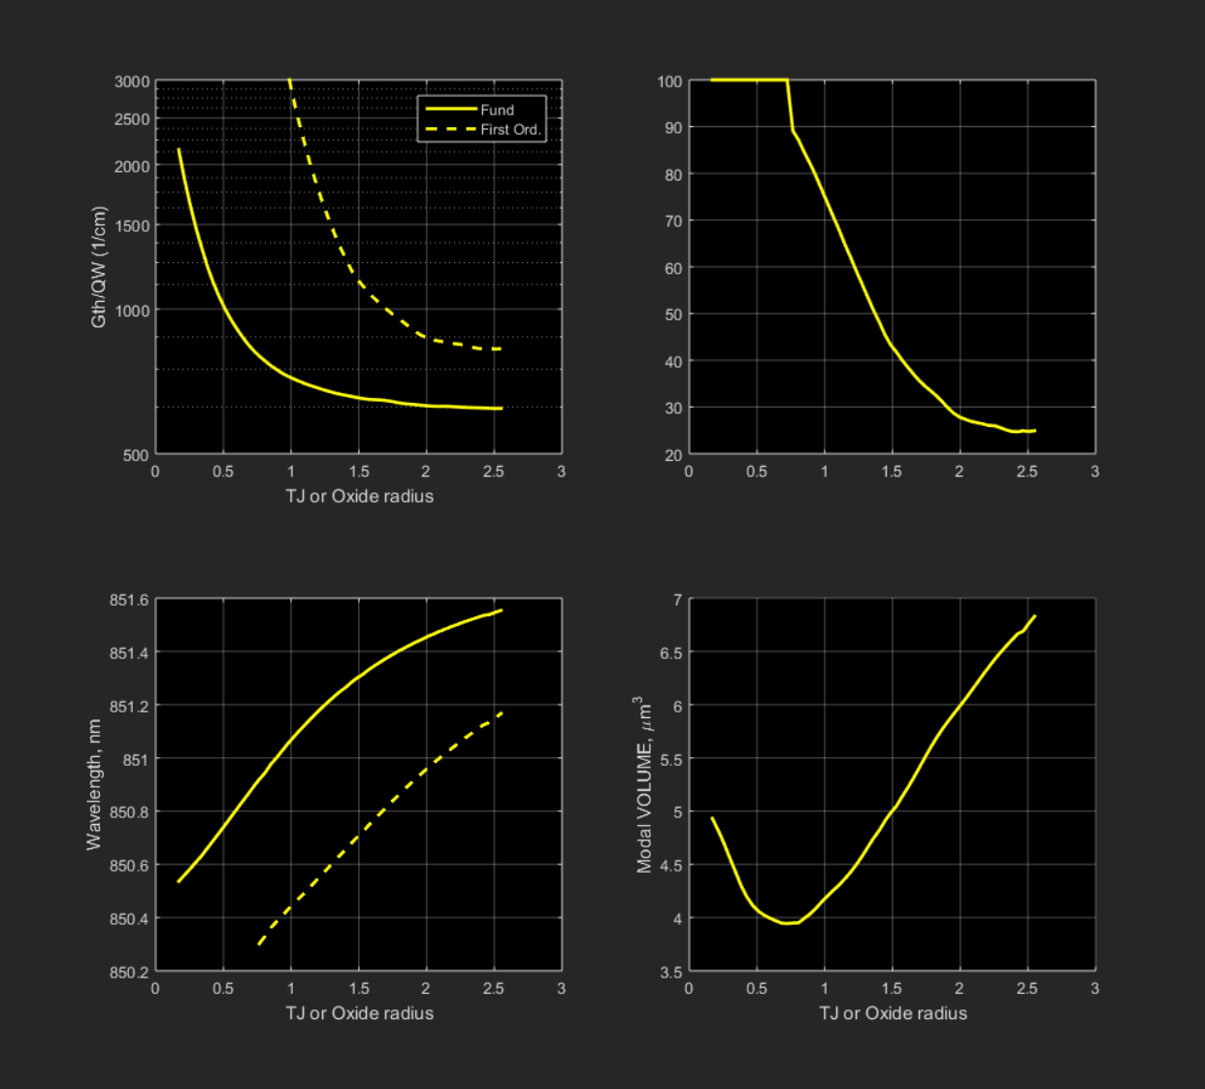
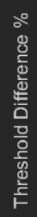

Standard Oxide VCSEL
Threshold Difference = (1-G0/G1)x100
G1
G0
Contact Ring

Slide 12
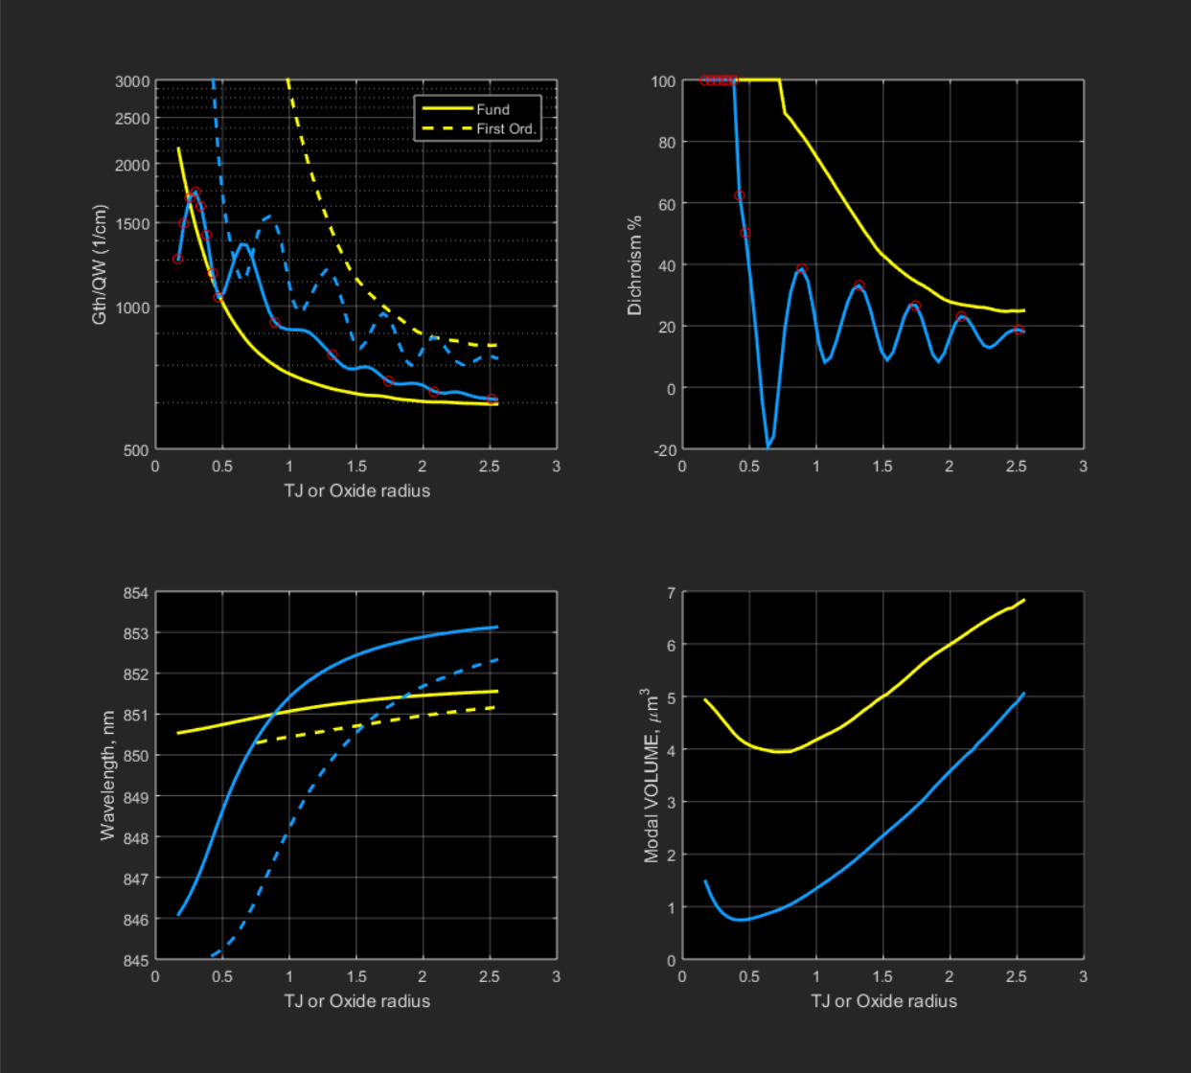
TJ VCSEL
10nm TJ Relief

Slide 13
10nm TJ Relief
1.25 um exp.
Minimum at 0.75 um OXIDE radius
Close to Berlin results

Slide 14
10nm TJ Relief
Factor 5 !
Minimum at 0.75 um OXIDE radius
Minimum at 0.40 um for TJ radius

Slide 15
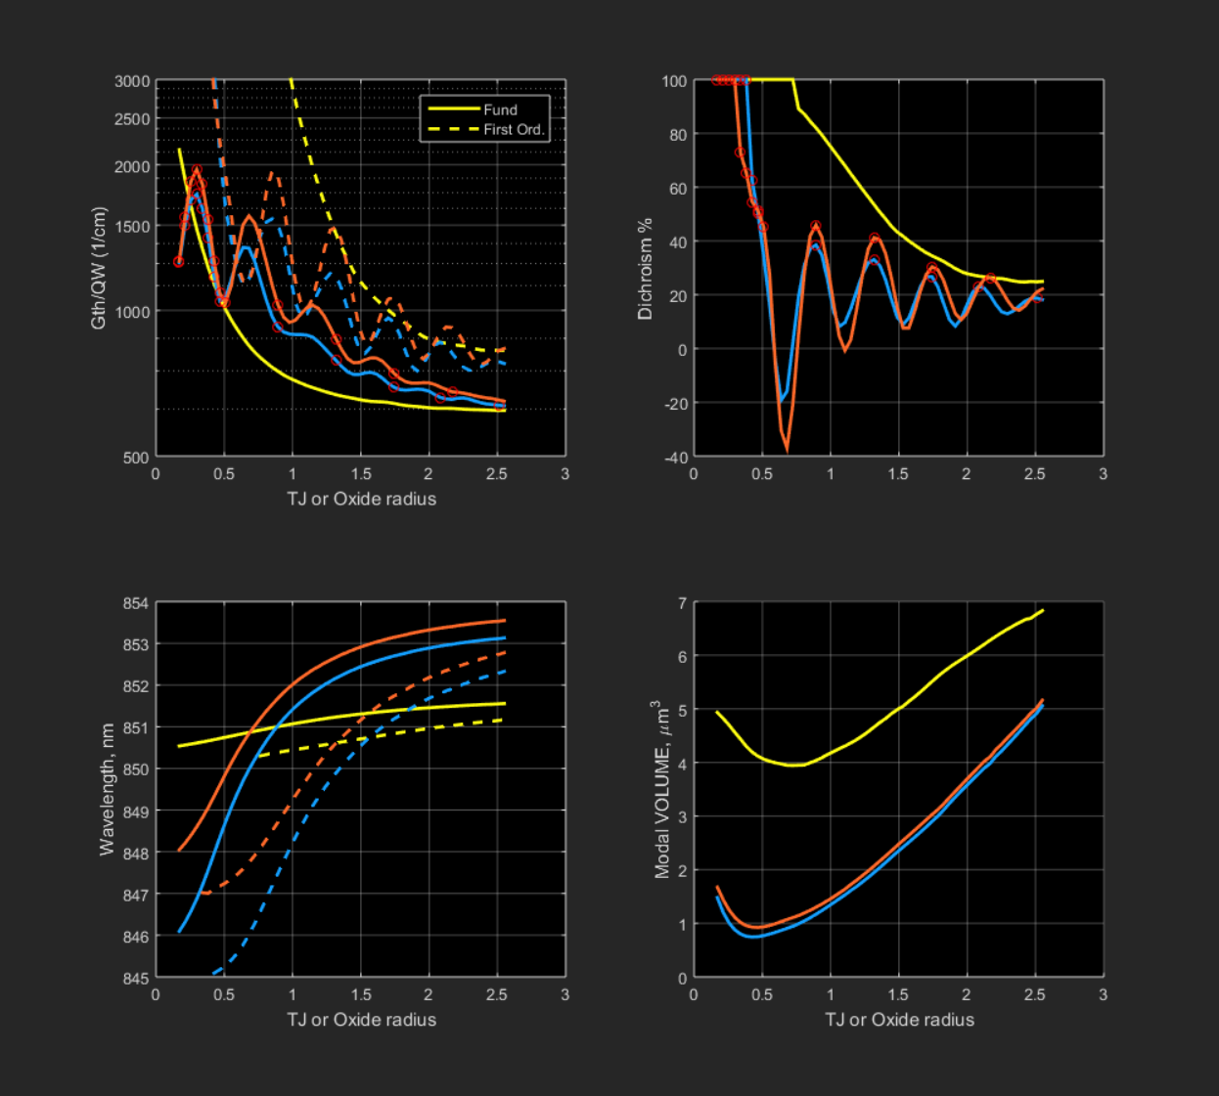
3 TJ VCSEL
3 λ cavity

Slide 16
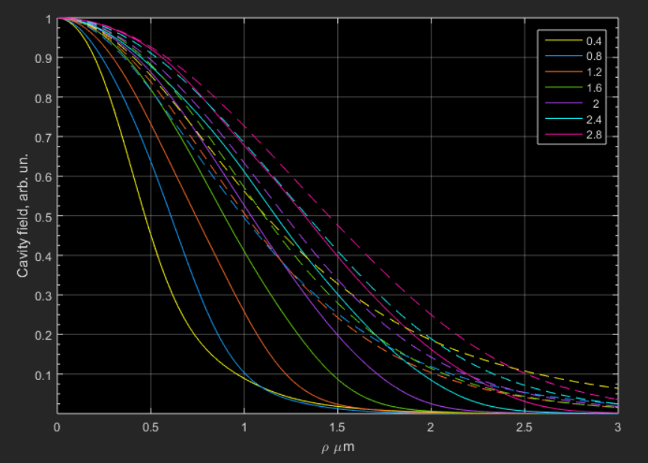
Reason for Modal Volume difference:
Oxide (dashed lines) provides a much lower confinement.

Slide 17
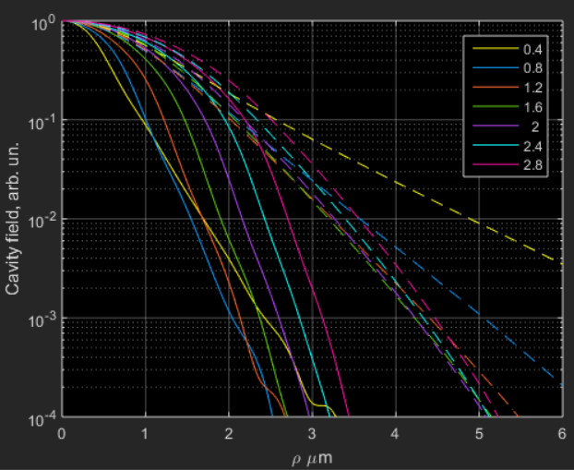
Reason for Modal Volume difference:
Oxide (dashed lines) provides a much lower confinement.

Slide 18
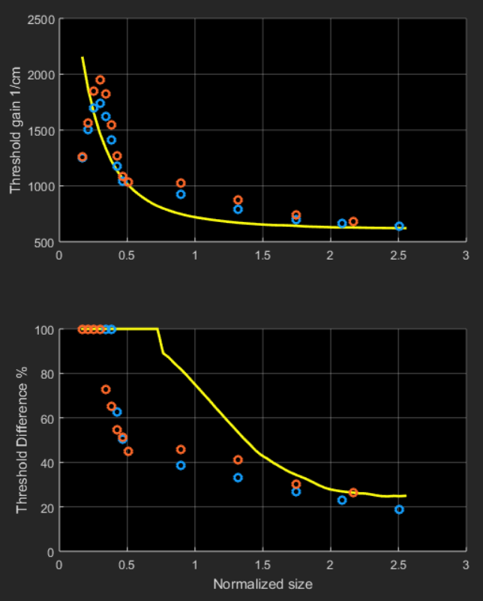
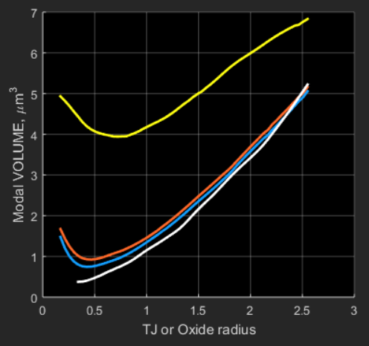
In summary
Threshold
Mode Volume
Oxide
TJ
Single mode operation
20nm TJ relief, 0.5um radius
Gth=2000/cm

Slide 19
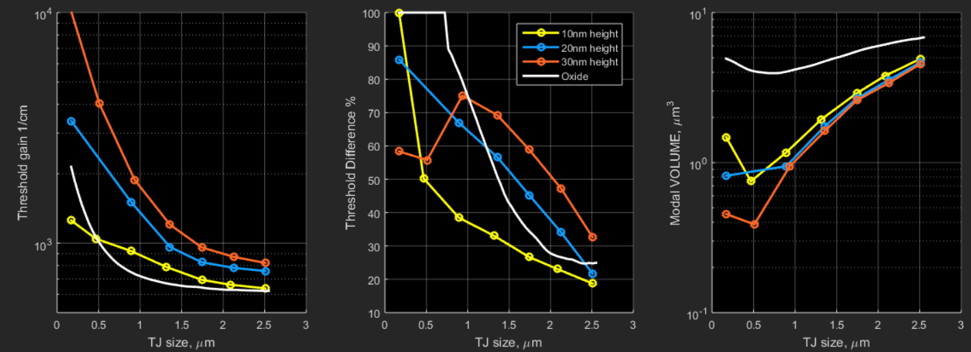
Effect of TJ-relief height: small volume
F_{max} x 2
F_{max} x 3, BUT G_{th} x 4

Slide 20
Effect of TJ-relief height: standard volumes
Better SM
performance
Not too bad
threshold penalty
F_{max} x 1.5

Slide 21
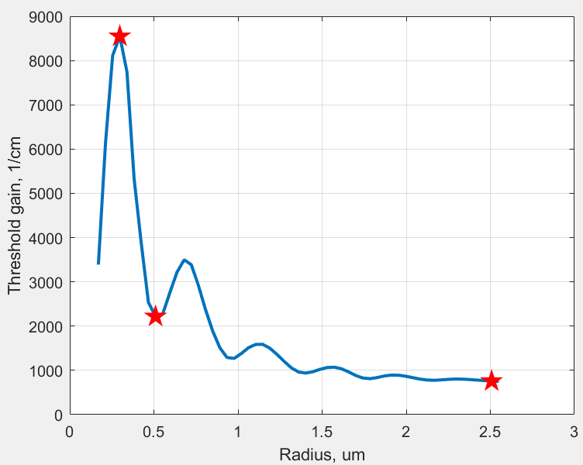
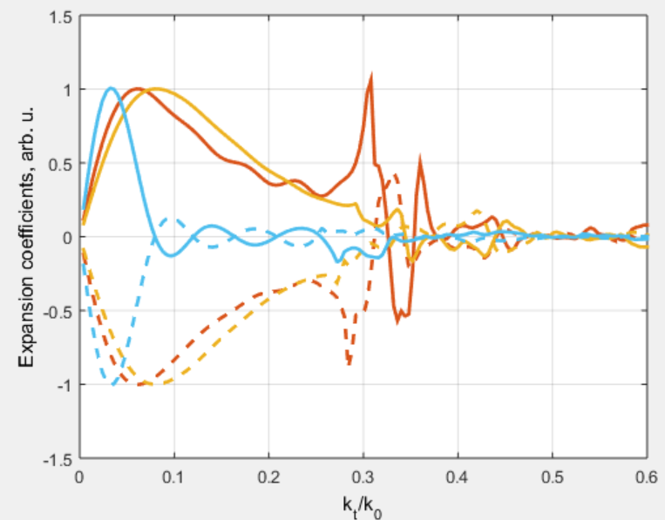
Relief scattering loss investigation
1
Size
Scattering
losses
TE comp.
1
2
3
2
TM comp.
3
Total Reflection at
air interface
Notes:
EigTOT.fig, da aprire con Matlab2015

Slide 22
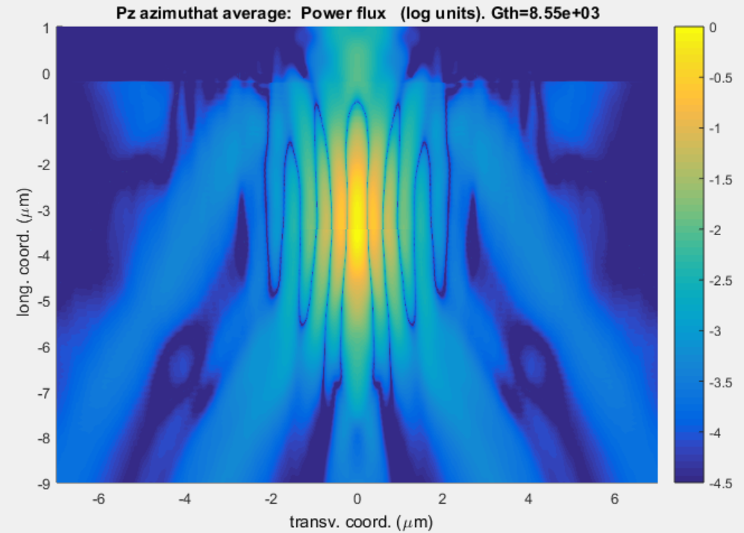
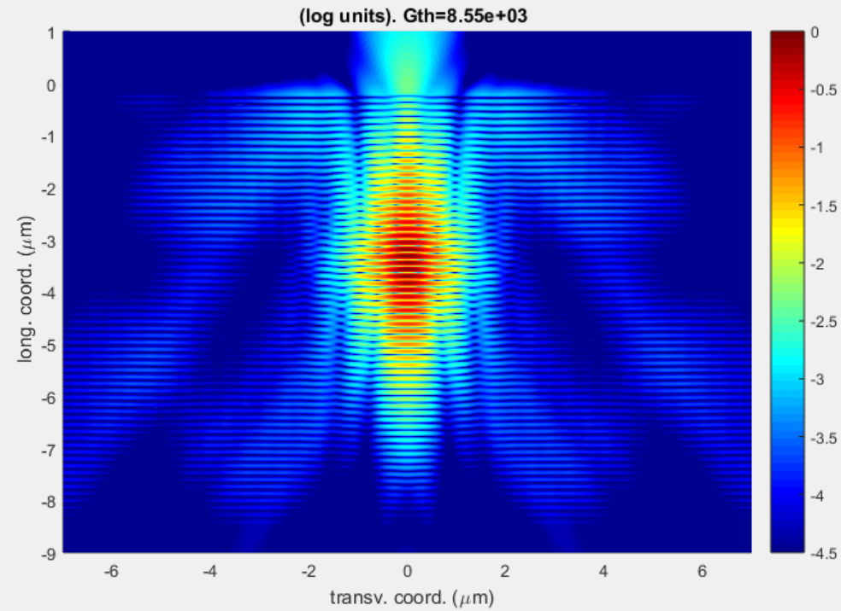
Relief scattering loss investigation
1

Slide 23
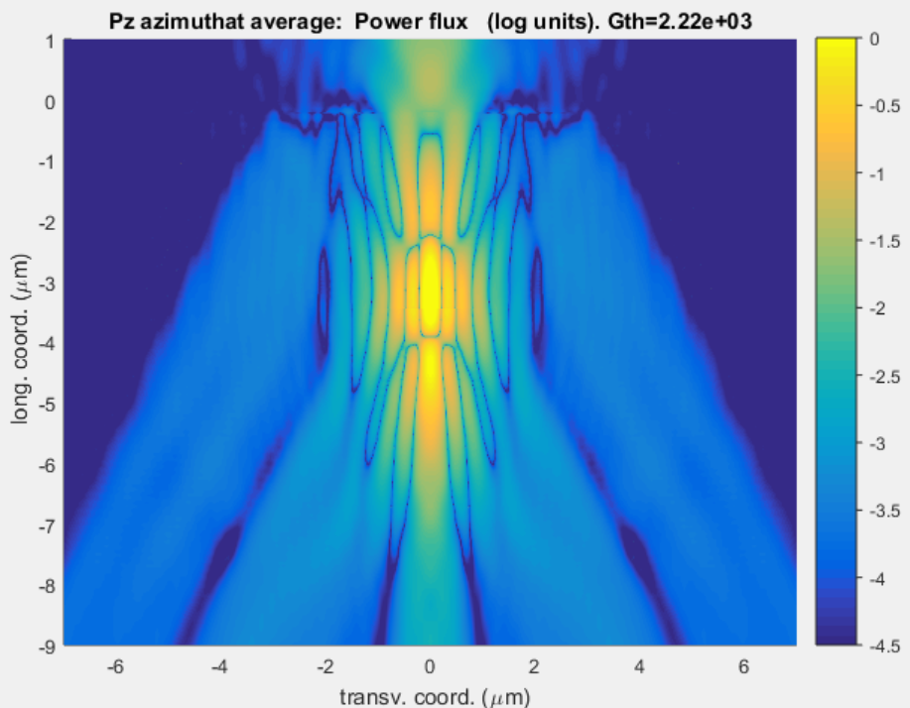
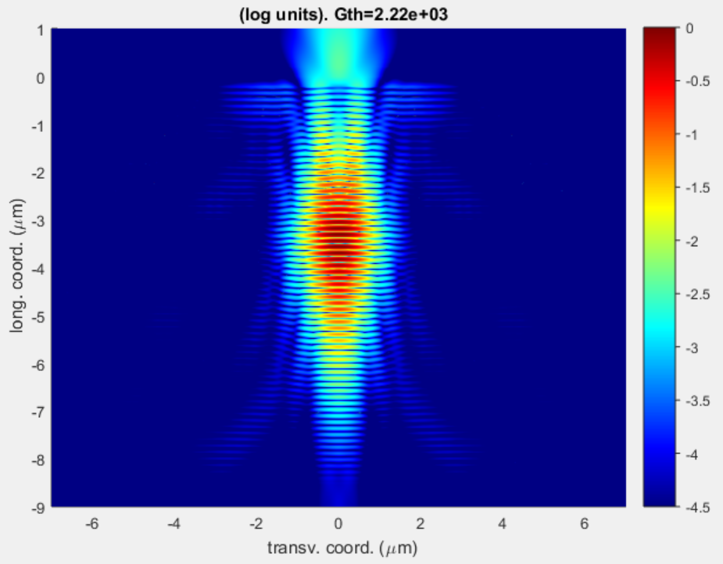
Relief scattering loss investigation
2

Slide 24
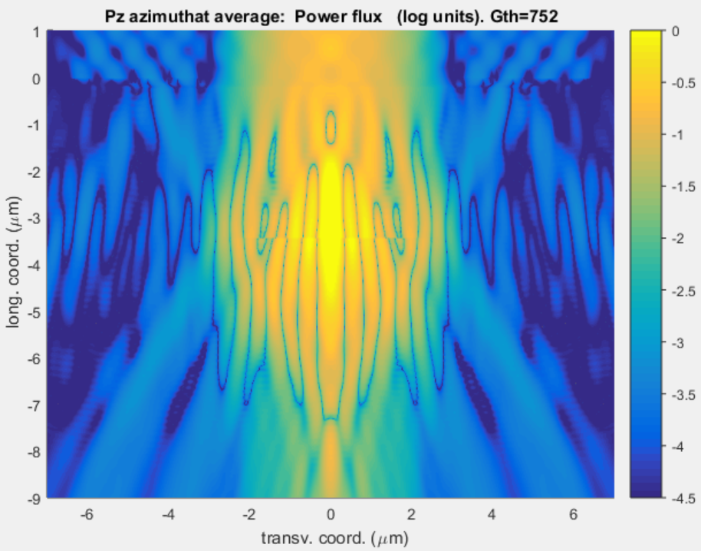
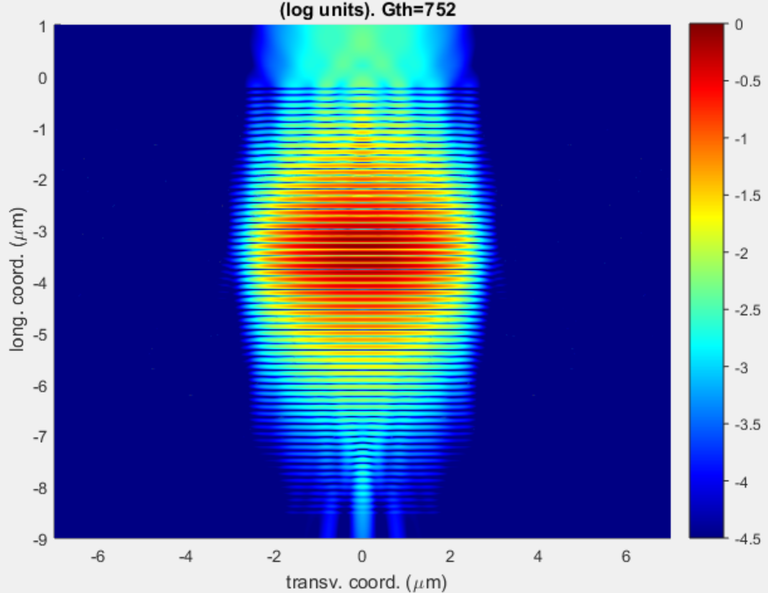
Relief scattering loss investigation
3

Slide 25
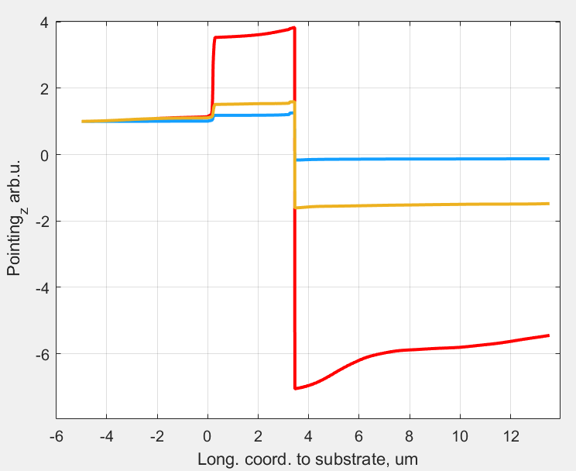
Relief scattering loss investigation
1
Size
Metal Ring
1
2
3
QW section
Air interface
2
3
Notes:
Gth_th6.fig da TJTH-6-1-RED_0_Diel0_Loss-10_Mir5_IK1
PzFINAL

Slide 26
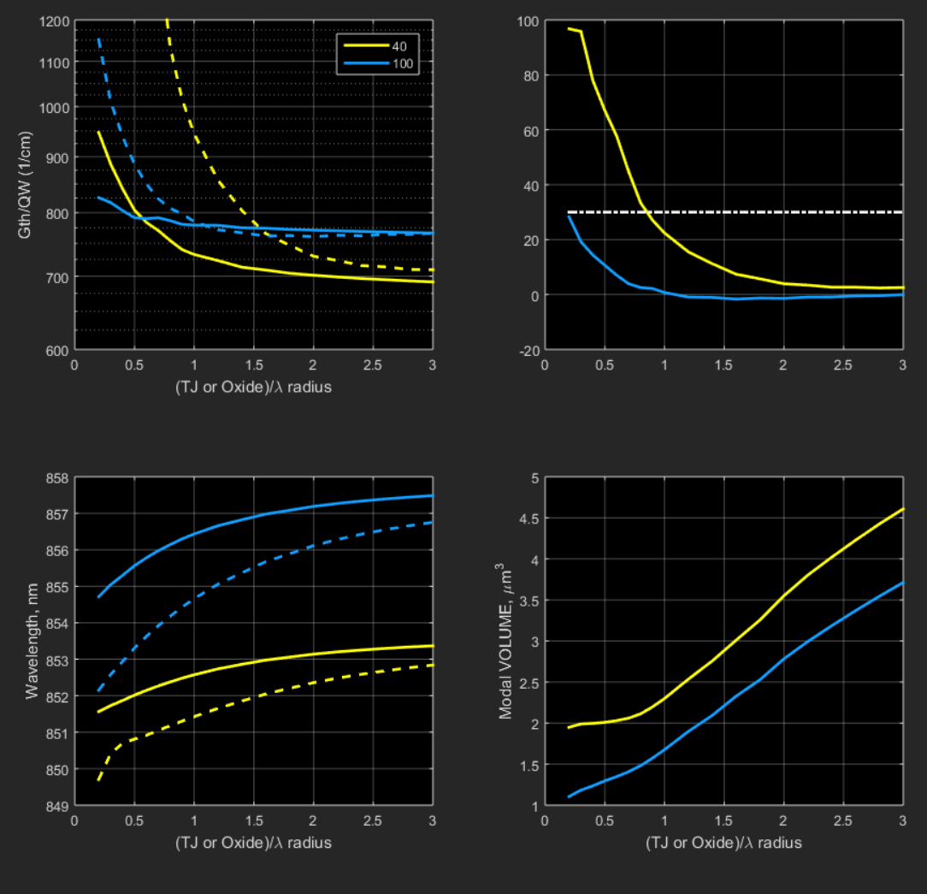
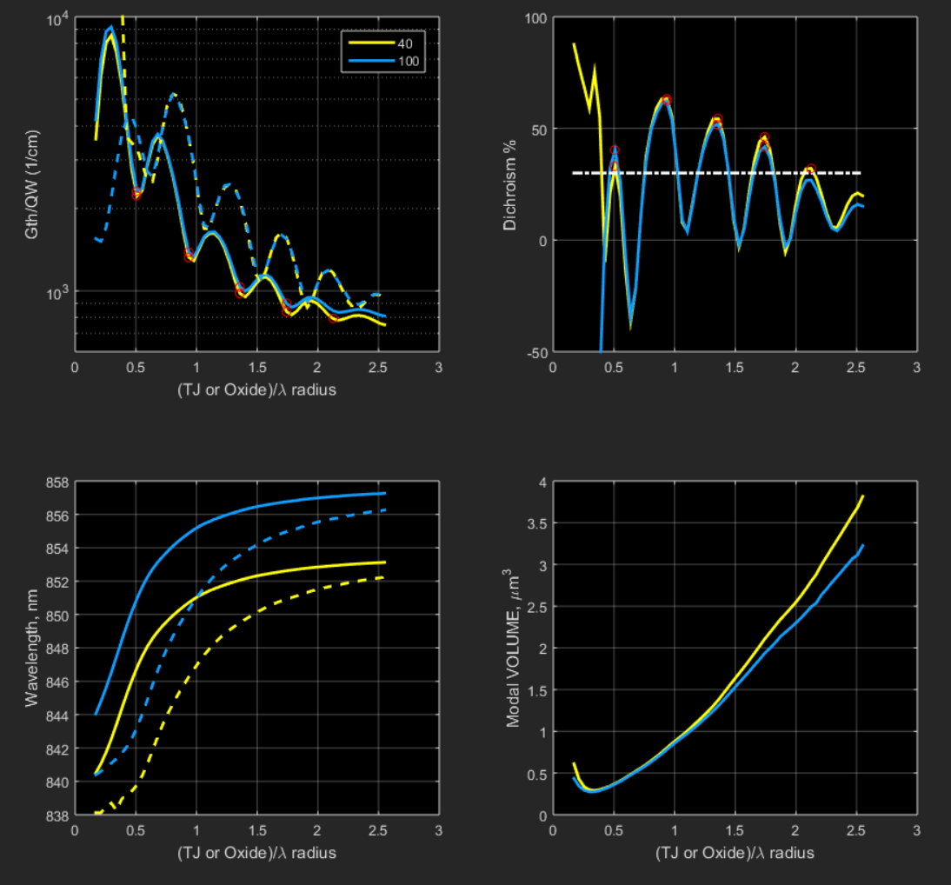
Effect of thermal lensing
Delta_Tmax= 40 and 100
Standard Oxide VCSEL
Lithographic VCSEL 20nm Relief
Notes:
plotGaAs
MainGaAsOxTEMP MainGaAsMETtjth6TEMP
fi_add= 'TempOxREFpp-0-RED_0_Diel0_Loss-10_Mir5_IK1’ fi_add= 'TempTJTH-6-1-RED_0_Diel0_Loss-10_Mir5_IK1'

Slide 27
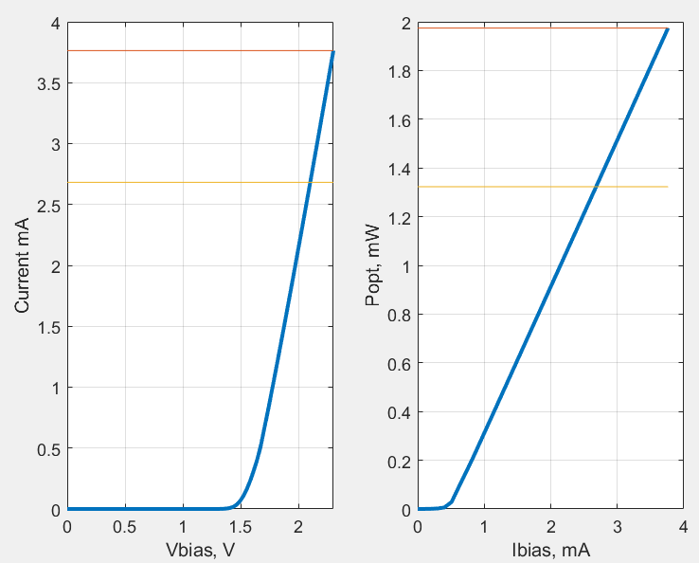
Dynamics: preliminary results Martino D’Alessandro

Slide 28
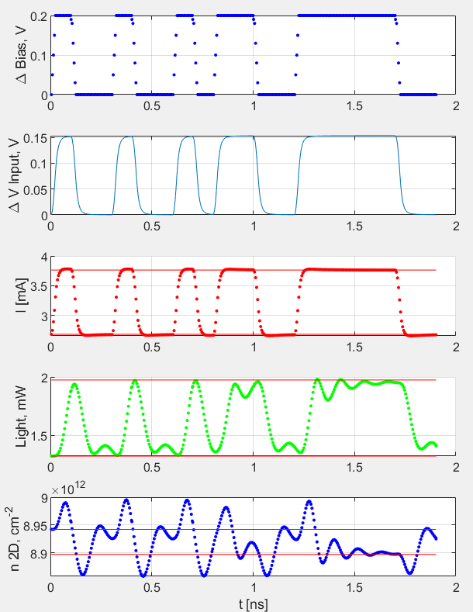
Dynamics: preliminary results Martino D’Alessandro
Period 0.1 ns (10GHz)

Slide 29
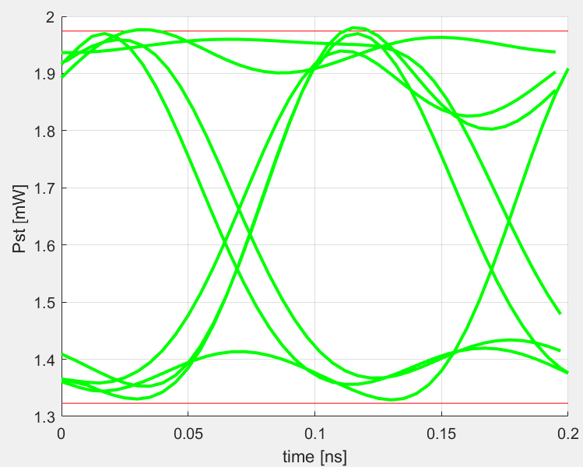
Dynamics: preliminary results Martino D’Alessandro
Period 0.1 ns (10GHz)

